Slide 1

Visual Story
Planning your visit to
Access, Ideas & Insights: Accessible Curation

Slide 2
What is a Visual Story
A Visual Story is a visual & written accessible guide to assist you with your visit.
Visual stories are used to prepare a person for and increase the predictability of a new environment or situation. This helps bring familiarity to a process and to reduce anxiety and stress.
This guide provides information on how to access Accessible Curation at Artspace, what to expect when you arrive and who to ask for assistance.
ACCESSIBLE ARTS | ACCESS, IDEAS AND INSIGHTS: ACCESSIBLE CURATION | VISUAL STORY

Slide 3

Access Ideas and Insights:
Accessible Curation
Access, Ideas, and Insights, presented by Accessible Arts, is a free series of hybrid events. These events focus on topics related to access and inclusion in the arts sector.
The next event theme is Accessible Curation. It's scheduled for Tuesday 14
May. You can join us either online
or in-person at Artspace.
During the event, curators will discuss various curatorial practices and approaches to accessibility.
ACCESSIBLE ARTS | ACCESS, IDEAS AND INSIGHTS: ACCESSIBLE CURATION | VISUAL STORY

Slide 4
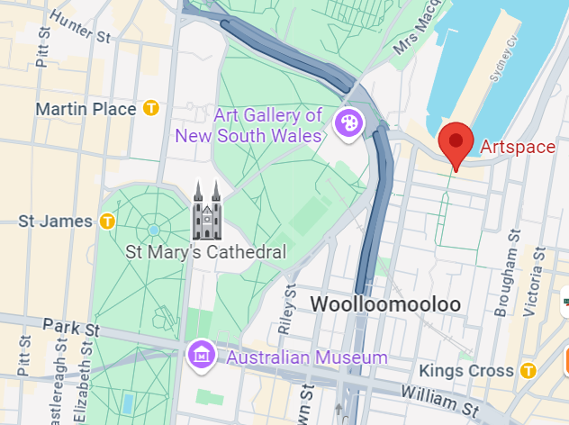
Planning Your Visit by Train or Bus
The event will be held at Artspace - 43/51 Cowper Wharf Roadway, Woolloomooloo
The closest train stations are Kings Cross or St James. Kings Cross Station is approximately 750 metres and an 11min walk from Artspace. St James Station is approximately a 15min walk and just over 1km from Artspace.
Bus route 311 runs between Central, Belmore Park and City Millers Point via Darlinghurst, with stops outside Artspace on Cowper Wharf Roadway.
ACCESSIBLE ARTS | ACCESS, IDEAS AND INSIGHTS: ACCESSIBLE CURATION | VISUAL STORY

Slide 5
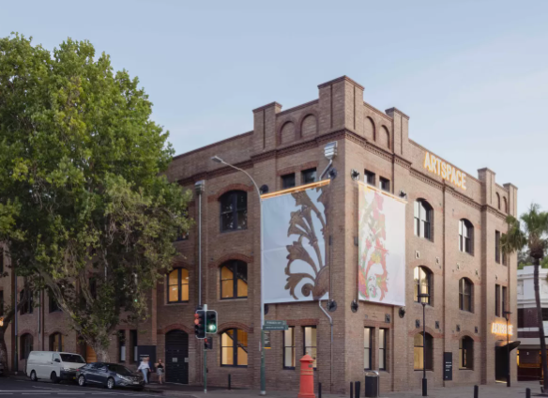
Planning Your Visit by Car
There is limited metered parking available at the entrance to Artspace on Cowper Wharf Roadway and at the rear of the building on Bland Street.
The closest publicly accessible car park
is The Wharf Woolloomooloo on Lincoln Crescent. It is approximately a three-minute walk from Artspace and can be booked in advance online.
For more information, you can click here: Plan your visit
ACCESSIBLE ARTS | ACCESS, IDEAS AND INSIGHTS: ACCESSIBLE CURATION | VISUAL STORY

Slide 6
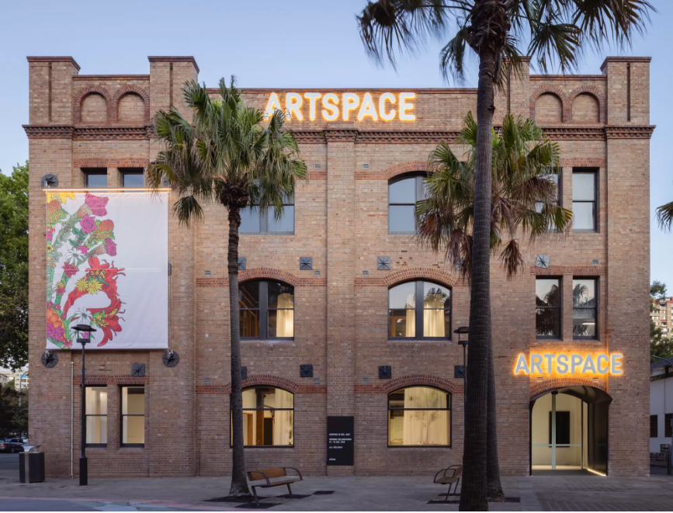
Artspace
Located on Gadigal land, Artspace is a premier institution for contemporary art in the Asia Pacific region.
Accessible Curation will take place within the Multipurpose Space
located on level 2 of The Gunnery Building, accessible via stairs or an elevator.
I can find out more about Artspace and their upcoming exhibitions by clicking here: What’s On
ACCESSIBLE ARTS | ACCESS, IDEAS AND INSIGHTS: ACCESSIBLE CURATION | VISUAL STORY

Slide 7
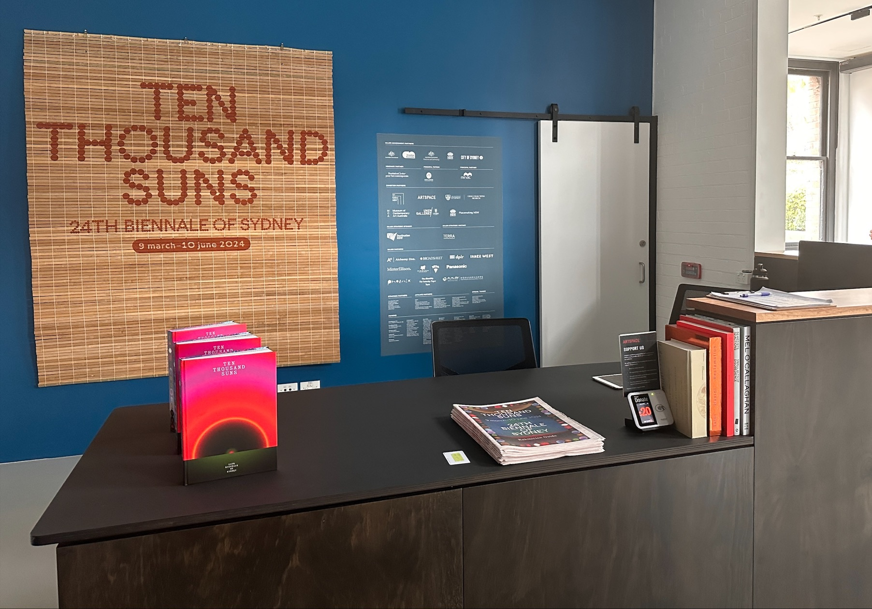
Entrance and Information Desk
When arriving at Artspace, I can find the information desk located at the entrance. Here, I can ask Artspace staff about ongoing exhibitions, upcoming events, and even seek directions to facilities such as the toilets.
This is also the place where I can safely store my belongings while I'm at the event or exhibition. When I'm ready to leave, I can come back to the information desk to collect them.
ACCESSIBLE ARTS | ACCESS, IDEAS AND INSIGHTS: ACCESSIBLE CURATION | VISUAL STORY

Slide 8
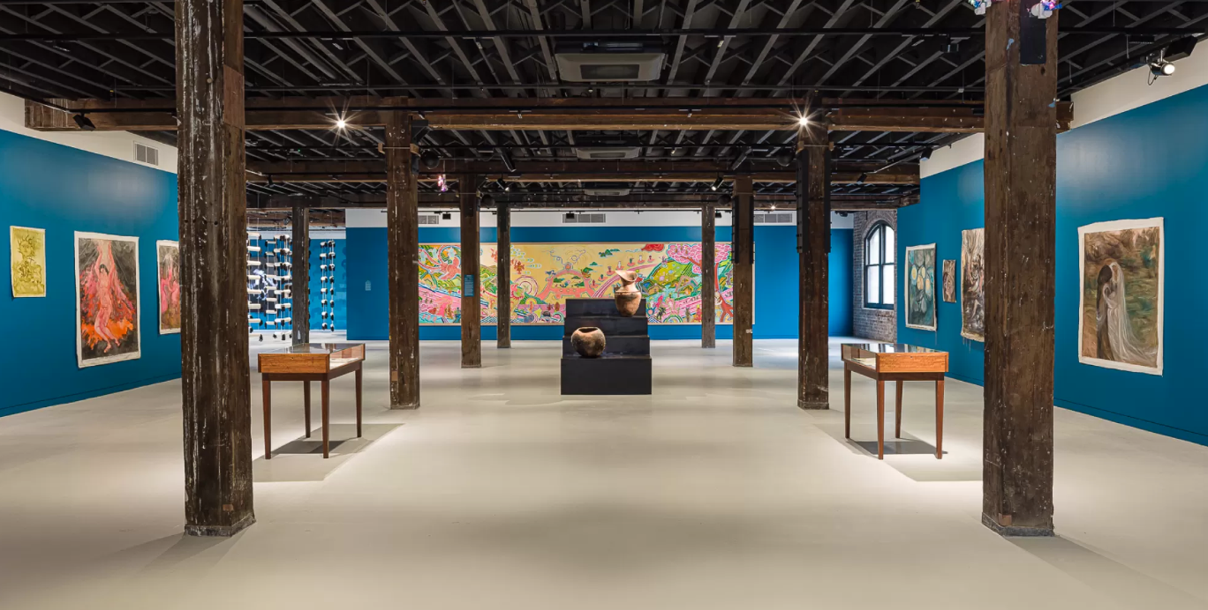
Exhibition Space
I can explore the gallery space on the ground floor before and after the event. Currently, the exhibition "Ten Thousand Suns" from the 24th Biennale of Sydney is on display. Admission to this exhibition is free.
No food or drink can be taken into the exhibition space.
I can find out more about the exhibition here: Ten Thousand Suns
ACCESSIBLE ARTS | ACCESS, IDEAS AND INSIGHTS: ACCESSIBLE CURATION | VISUAL STORY

Slide 9
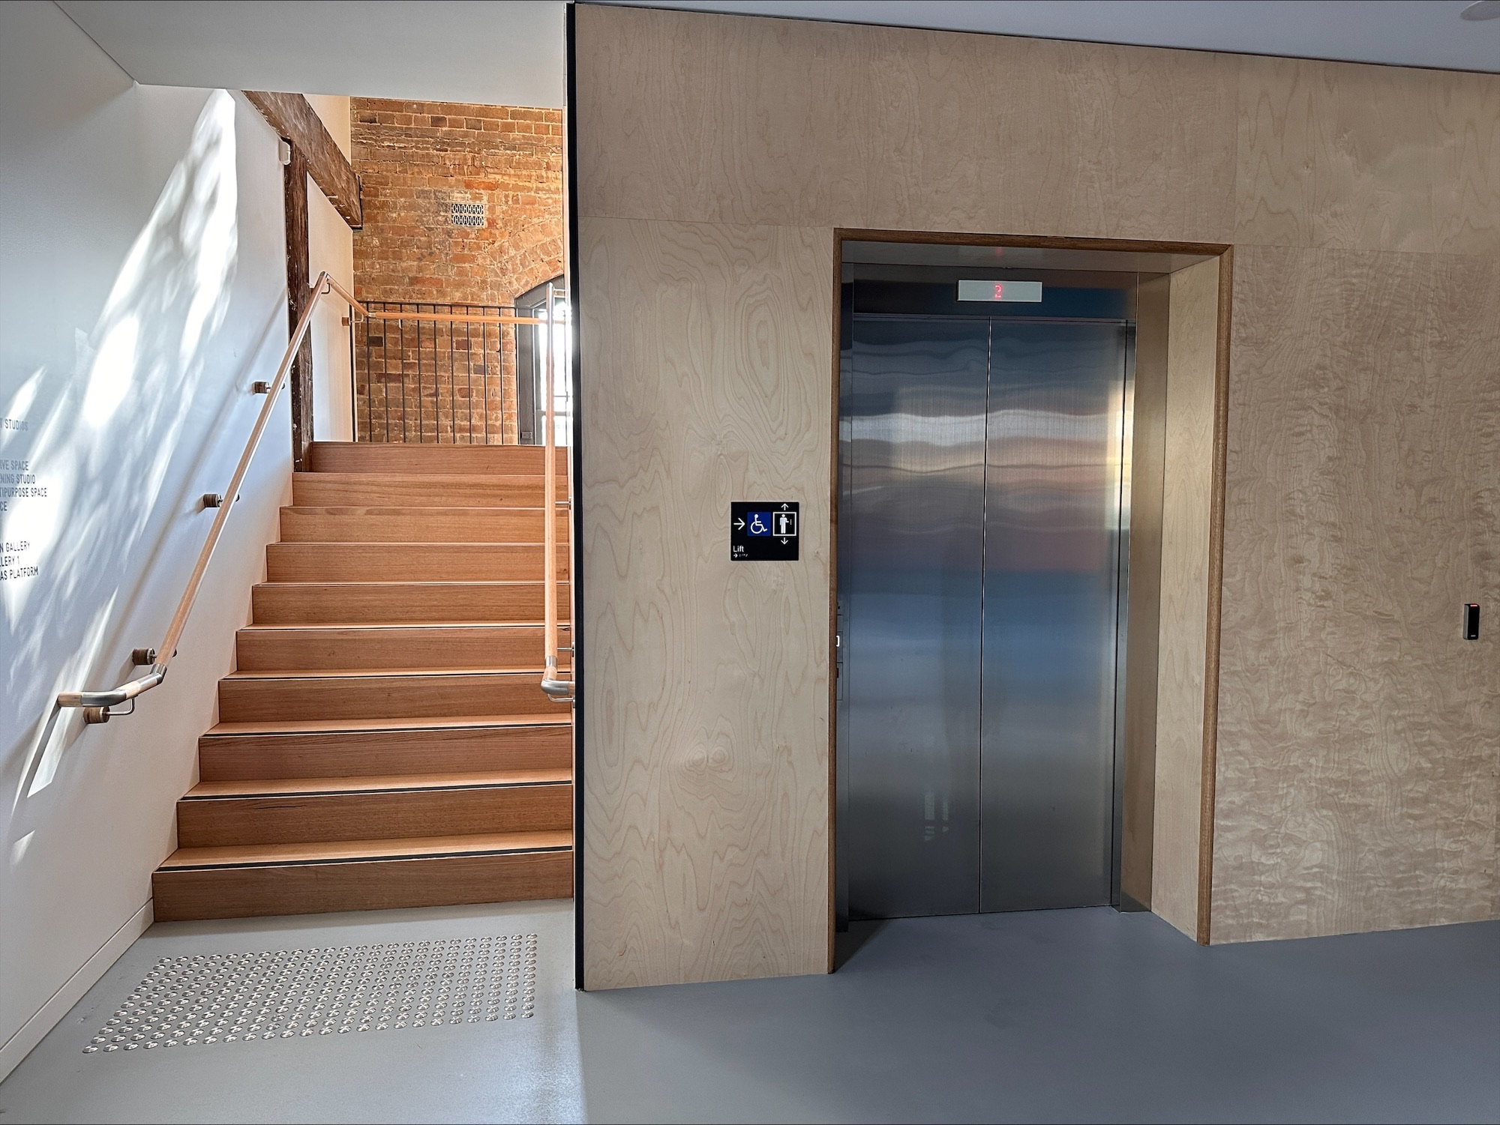
How to get to the event space
Across from the foyer, opposite the information desk, there's an elevator alongside a set of stairs. I can use either of these to reach Level 2, where I'll find the entrance to the event in the Multipurpose Space.
Accessible Arts staff members will be stationed throughout the venue to assist with wayfinding.
ACCESSIBLE ARTS | ACCESS, IDEAS AND INSIGHTS: ACCESSIBLE CURATION | VISUAL STORY

Slide 10
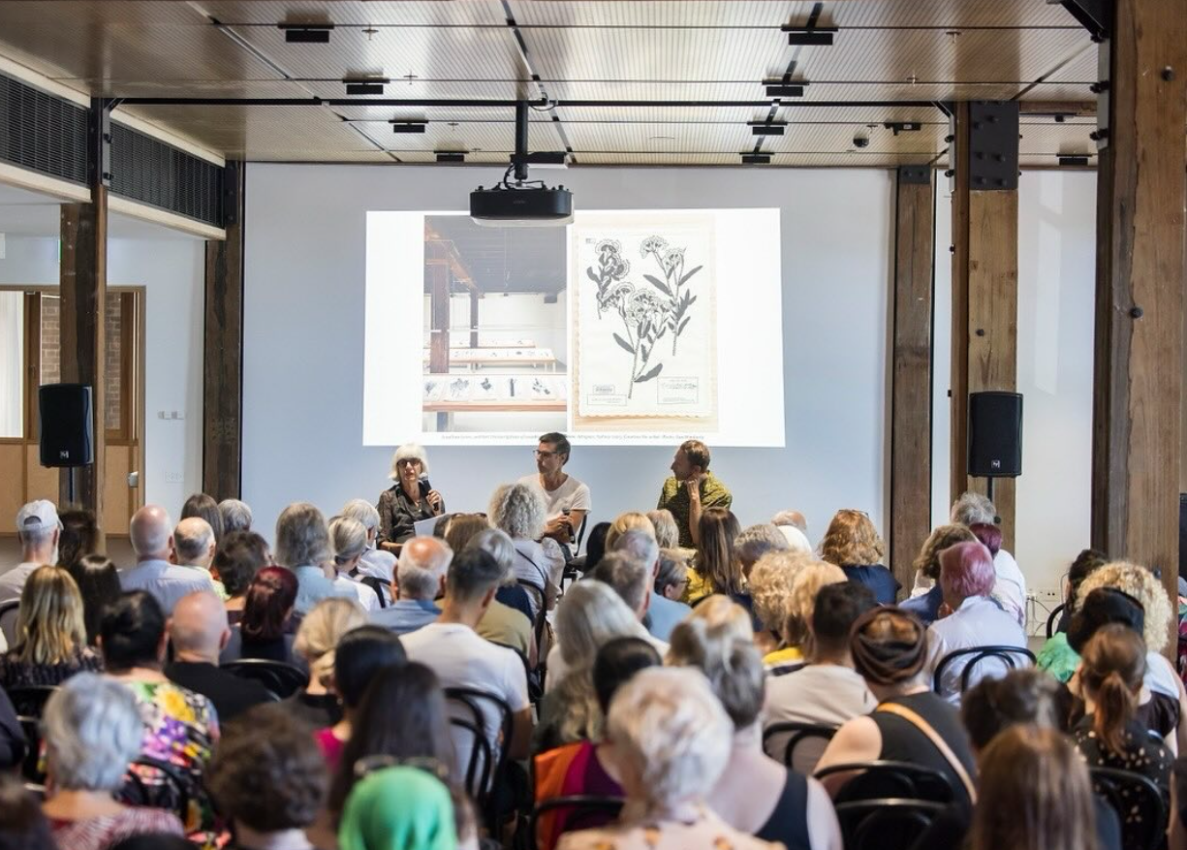
Multipurpose Space
At the entrance to the Multipurpose Space, I will be greeted by Accessible Arts staff who will be wearing pink lanyards with their name on it. I will be asked to wear a sticker with my name on it so people can identify me.
Inside the event space I will see a stage and chairs set up in rows.
I can choose to sit anywhere I feel comfortable, except for chairs with a reserved sign on them.
ACCESSIBLE ARTS | ACCESS, IDEAS AND INSIGHTS: ACCESSIBLE CURATION | VISUAL STORY

Slide 11
Event start times and refreshments
Doors to the event will open at 2:45 pm, with the program starting at 3pm with a Welcome to Country.
Following the welcome, a panel discussion featuring three speakers and an MC will take place on stage. The panel discussion will last for 1 hour concluding with an audience Q&A session where I can ask a question to the panellists. Questions will be welcomed from both the online and in-person audience.
From 4pm to 4:30pm, I can enjoy free light refreshments, coffee, and tea in the Multipurpose Space. Gluten-free options will be available.
During the event, a photographer will be taking pictures, and audio and video equipment will be used because the event will be live-streamed.
ACCESSIBLE ARTS | ACCESS, IDEAS AND INSIGHTS: ACCESSIBLE CURATION | VISUAL STORY

Slide 12

Access at the event
The event will be Auslan interpreted and live captioned. Artspace is universally accessible.
If I require an accessible seat, I can approach the Accessible Arts staff, and they will assist me in finding one.
If I want to ask about specific access requirements before the event, I can reach out to the Accessible Arts team by clicking here: Contact Us
ACCESSIBLE ARTS | ACCESS, IDEAS AND INSIGHTS: ACCESSIBLE CURATION | VISUAL STORY

Slide 13
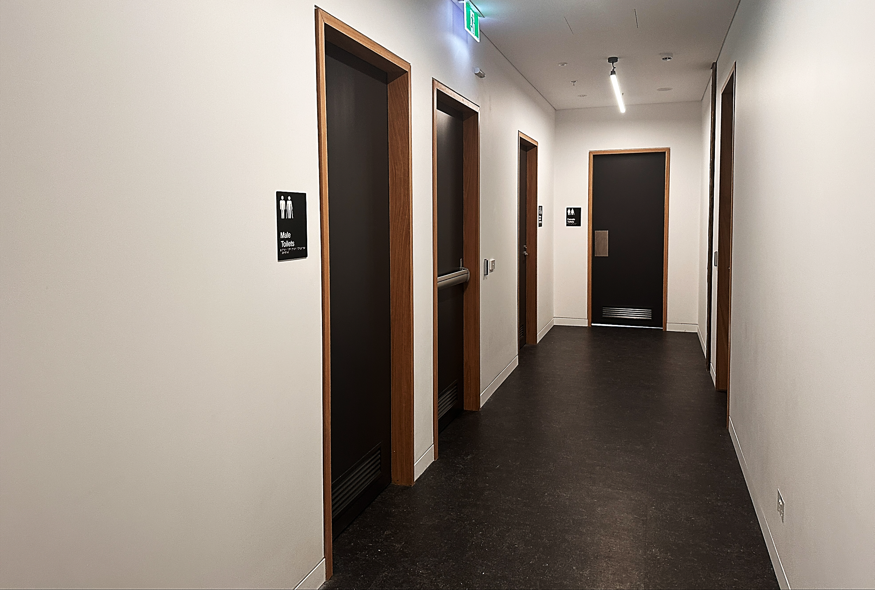
Public Toilets
Accessible toilets are located next to to the Multipurpose Space on Level 2.
To reach them, I can exit through the doors in the middle of the Multipurpose Space. From there, a corridor will lead me to the toilets. Clear signs are posted outside the toilets to guide me to the facilities.
If I need assistance in finding them, I can ask the Accessible Arts staff for help.
ACCESSIBLE ARTS | ACCESS, IDEAS AND INSIGHTS: ACCESSIBLE CURATION | VISUAL STORY

Slide 14
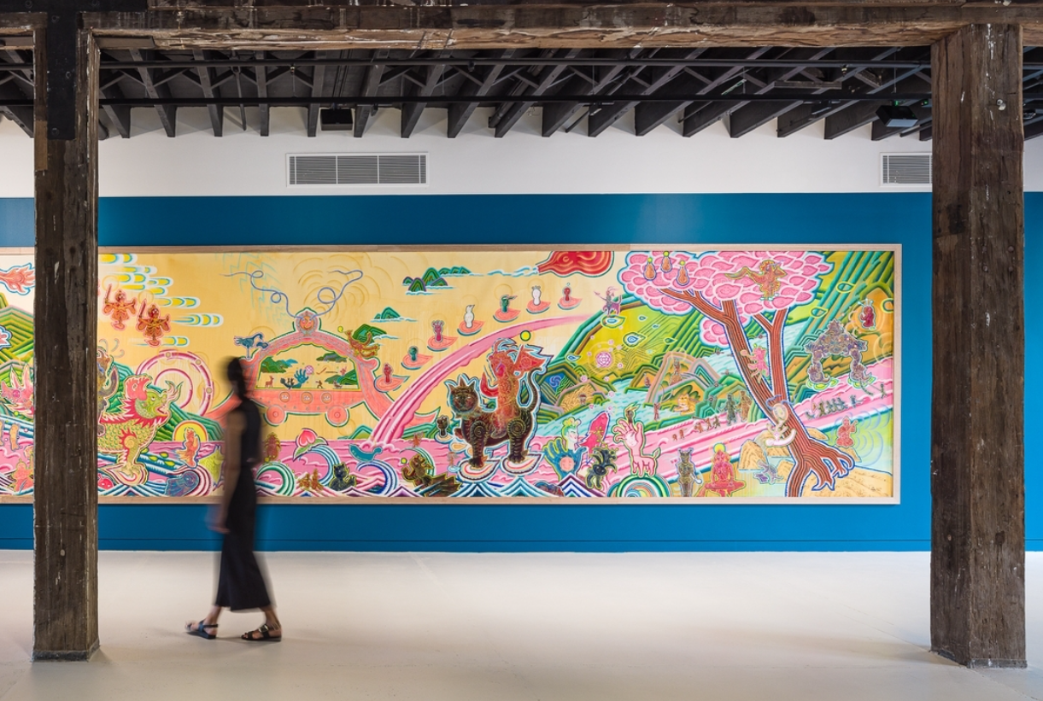
Leaving the event
After the event ends, I can take some time to explore the exhibitions.
The gallery closes at 5pm. When it's time to leave, I can head back to the main entrance on the Ground Level.
Artspace is approximately a
10min walk from the Sydney CBD,
Kings Cross, Art Gallery of New South Wales and the Sydney Botanic Gardens.
I can find out more information
by clicking here: Artspace
ACCESSIBLE ARTS | ACCESS, IDEAS AND INSIGHTS: ACCESSIBLE CURATION | VISUAL STORY

