Slide 1

Visual Story
Planning your visit to:
Access, Ideas & Insights
The Future of Disability Storytelling

Slide 2
What is a Visual Story
A Visual Story is a visual & written accessible guide to assist you with your visit.
Visual stories are used to prepare a person for and increase the predictability of a new environment or situation. This helps bring familiarity to a process and to reduce anxiety and stress.
This guide provides information on how to access the Access, Ideas, and Insights: The Future of Disability Storytelling event at Sydney Theatre Company, and what to expect when you arrive and who to ask for assistance.
ACCESSIBLE ARTS | ACCESS, IDEAS AND INSIGHTS: THE FUTURE OF DISABILITY STORYTELLING | VISUAL STORY

Slide 3

Access Ideas and Insights
Access, Ideas, and Insights, presented by Accessible Arts, is a free series of hybrid events. These events are focused on access and inclusion in the arts sector, through panel discussions.
The event will be held at Sydney Theatre Company on Thursday, July 25th. I can join either online or in-person. To attend I must register for a ticket here: Free Ticket Registration
The theme for the event is: The Future of Disability Storytelling.
ACCESSIBLE ARTS | ACCESS, IDEAS AND INSIGHTS: THE FUTURE OF DISABILITY STORYTELLING | VISUAL STORY

Slide 4

Access Ideas and Insights:
The Future of Disability Storytelling
The panel will explore the exciting possibilities for the future of disability storytelling across a diverse range of arts practices and genres. The discussion will delve into narrative, agency, identity, technologies and more.
Panel members include:
Dan Daw - producer and performer
Michelle Cheng - Head of Creative Diversity, Television and Online Content at SBS
Fiona Murphy - Award-winning writer, editor, and arts critic
ACCESSIBLE ARTS | ACCESS, IDEAS AND INSIGHTS: THE FUTURE OF DISABILITY STORYTELLING | VISUAL STORY

Slide 5
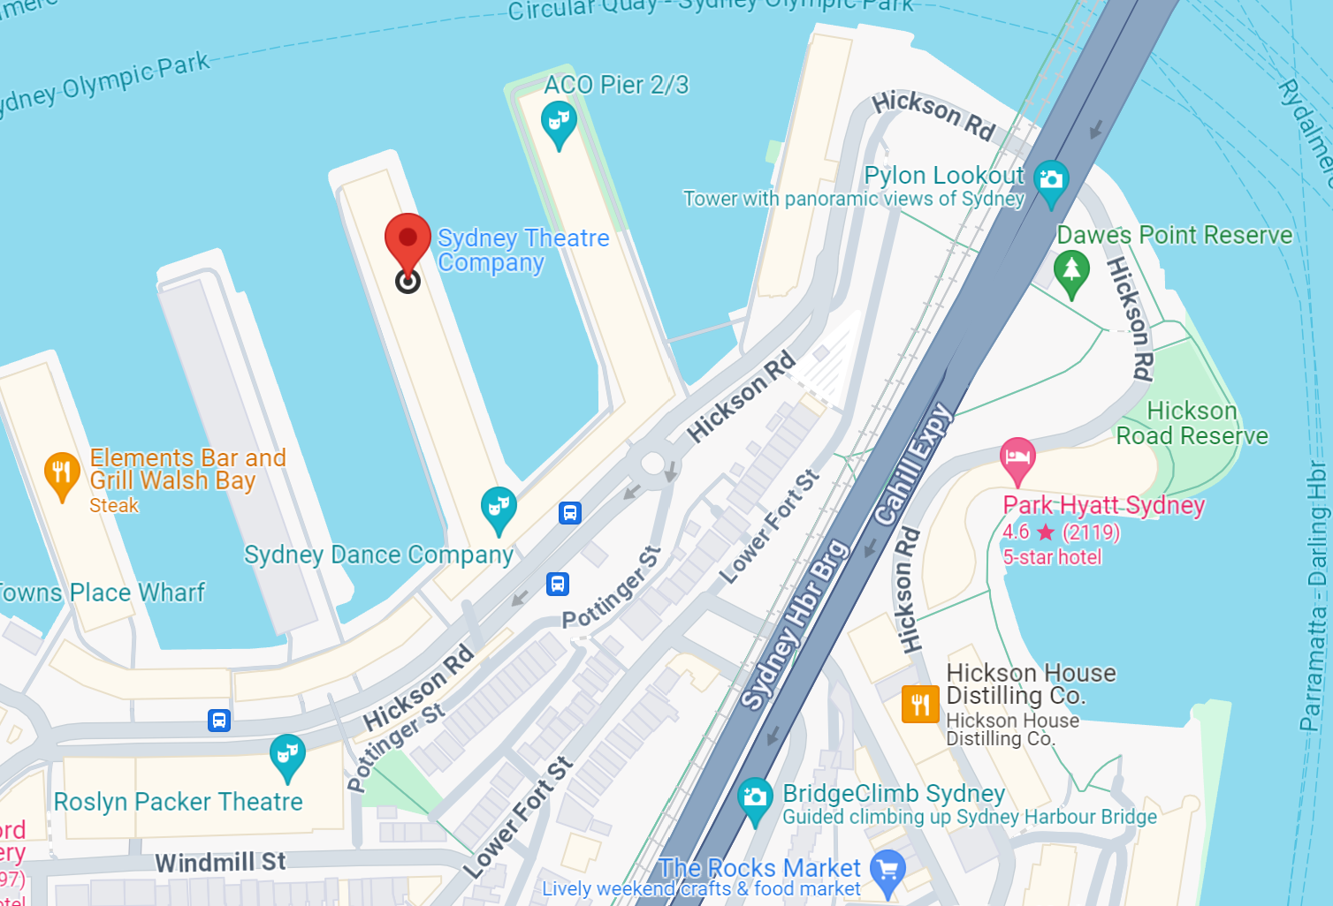
Planning Your Visit by Train or Bus
The event will be held at Wharf 2 Theatre at Sydney Theatre Company.
Address - Wharf 4/5 15 Hickson Road, Walsh Bay NSW 2000
The Wharf can be reached by the 324 and 325 bus services. These bus routes stop outside The Wharf Theatres.
Circular Quay railway station, bus and ferry terminus is the closest public transport hub. The Wharf is a 15-minute walk from both Circular Quay and Wynyard stations.
ACCESSIBLE ARTS | ACCESS, IDEAS AND INSIGHTS: THE FUTURE OF DISABILITY STORYTELLING | VISUAL STORY

Slide 6
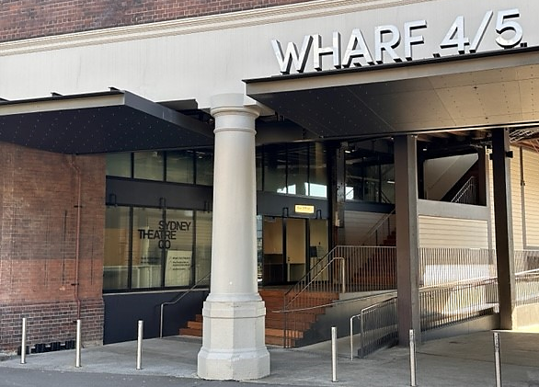
Planning Your Visit by Car
If traveling by car there is limited on-street parking available outside The Wharf on Hickson Road. I must arrive early as it can take more than 10 minutes to park, get to the event and be seated.
There is a drop-off and pick-up point right outside on Hickson Road. I cannot park my car here as it is only for dropping off and picking up people.
I can find out more information about getting to the event here: Plan your visit
ACCESSIBLE ARTS | ACCESS, IDEAS AND INSIGHTS: THE FUTURE OF DISABILITY STORYTELLING | VISUAL STORY

Slide 7


Sydney Theatre Company
Located on Gadigal land, Sydney Theatre Company (STC) is one of Australia's leading theatre companies. Established in 1978, the company produces a diverse range of theatrical performances, from classic plays to contemporary works and new Australian productions.
I can find out more about Sydney Theatre Company and their upcoming shows by clicking here: What’s On
ACCESSIBLE ARTS | ACCESS, IDEAS AND INSIGHTS: THE FUTURE OF DISABILITY STORYTELLING | VISUAL STORY

Slide 8
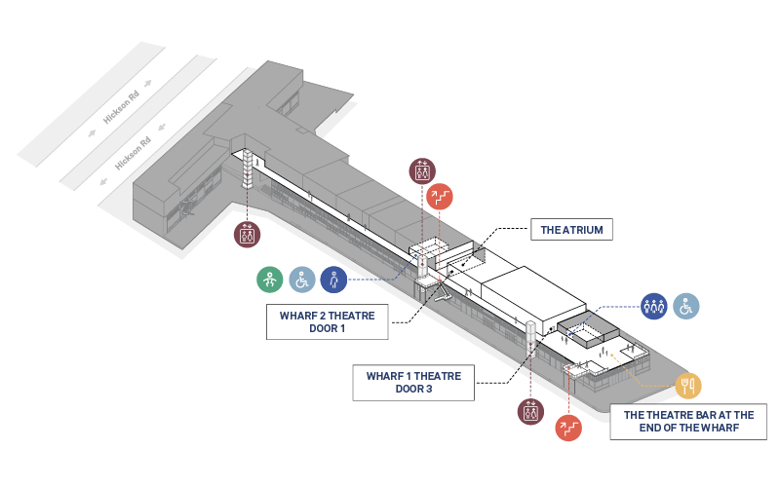
How do I get to Wharf 2
Wharf 2 Theatre is on Level 1 of the Wharf. Level 2 access is available via any of the three lifts along the along
of the Wharf, with the most direct access via the Mid-Wharf lift. I can get to the lifts by walking along the Pier.
Accessible Arts team members will be positioned throughout the venue to assist with wayfinding.
I can view the visitor map for more information: Visitor Map
Level 1
The Wharf
ACCESSIBLE ARTS | ACCESS, IDEAS AND INSIGHTS: THE FUTURE OF DISABILITY STORYTELLING | VISUAL STORY

Slide 9
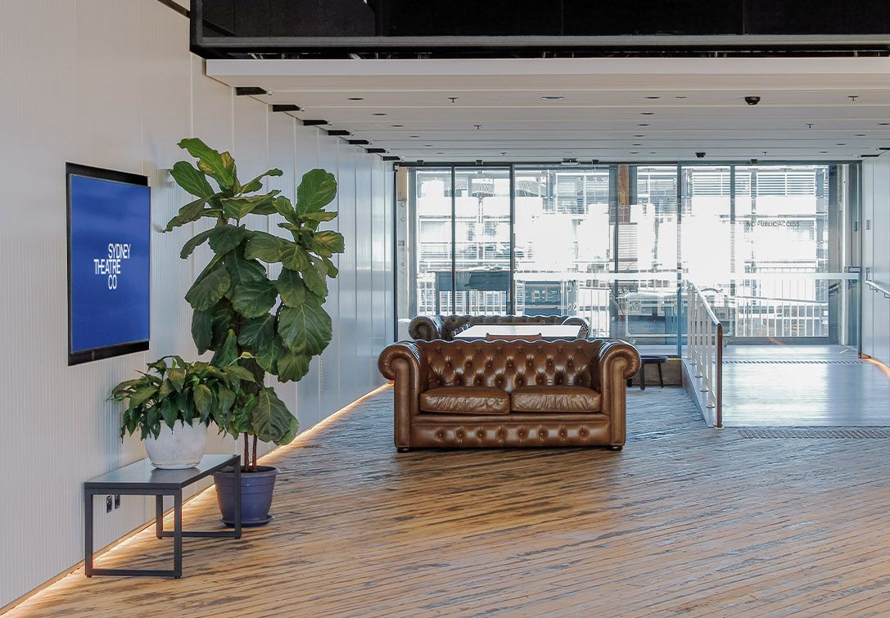
Atrium Space
Outside Wharf 2, I can find a waiting area with some seats, this is called the Atrium.
I can wait here before the event starts and the doors open.
If I need a break or a quiet space during the event, I can come to this area. This space is in the middle of the Wharf, so I might hear some noise from people walking by.
ACCESSIBLE ARTS | ACCESS, IDEAS AND INSIGHTS: THE FUTURE OF DISABILITY STORYTELLING | VISUAL STORY

Slide 10
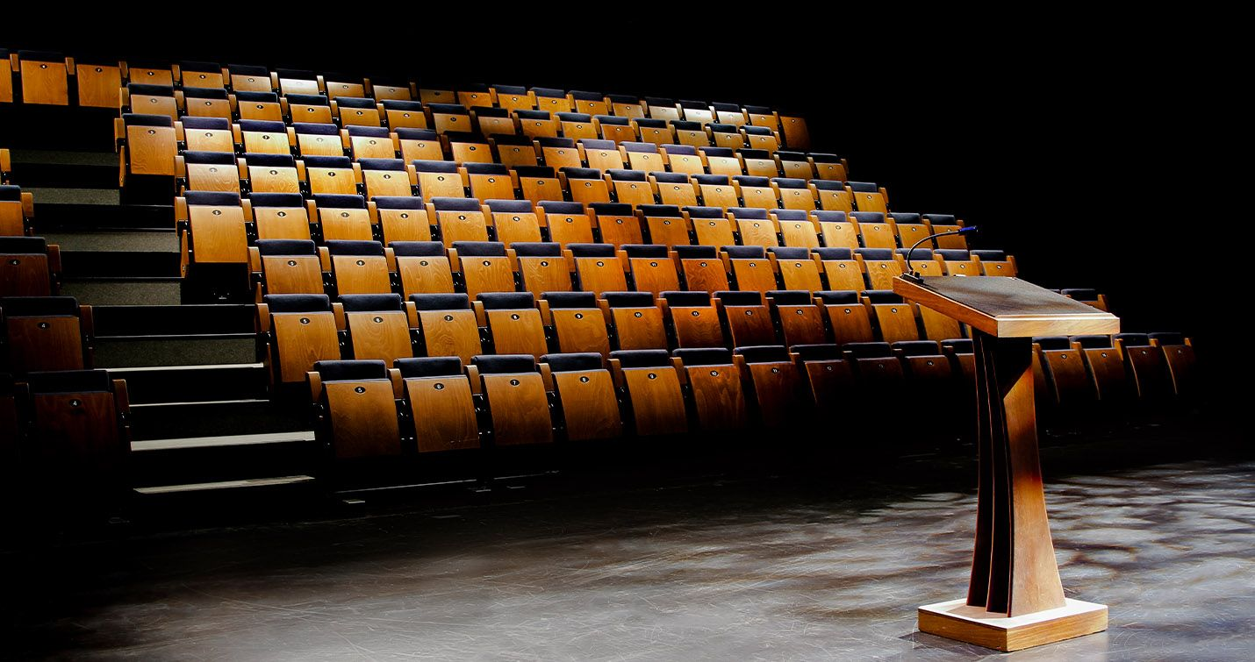
Wharf 2 – Theatre
At the entrance to the Wharf 2 Theatre, I will be greeted by Accessible Arts staff wearing pink lanyards with their names. They will ask for my name to check me in and provide me with a sticker displaying my name for easy identification.
Inside I will see rows of chairs ascending the stairs. I can choose to sit anywhere I feel comfortable, except for chairs marked with a reserved sign. Wharf 2 is wheelchair accessible.
ACCESSIBLE ARTS | ACCESS, IDEAS AND INSIGHTS: THE FUTURE OF DISABILITY STORYTELLING | VISUAL STORY

Slide 11
Event start & ending time
Doors to the event will open at 1:45pm, with the program starting at 2pm with a Welcome to Country.
Following the welcome, a panel discussion featuring three speakers and an MC will take place on stage. The panel discussion will last for 45mins concluding with 15min audience Q&A session where I can ask a question to the panellists. Questions will be welcomed from both the online and in-person audience.
After the panel ends, I can go to the Bar at the End of the Wharf for a relaxed networking session from 3:30pm to 4pm.
During the event, a photographer will be taking pictures, and audio and video equipment will be used because the event will be live-streamed.
ACCESSIBLE ARTS | ACCESS, IDEAS AND INSIGHTS: THE FUTURE OF DISABILITY STORYTELLING | VISUAL STORY

Slide 12

Access at the event
The event will be Auslan interpreted and live captioned. Sydney Theatre Company is universally accessible.
If I require an accessible seat, I can approach the Accessible Arts staff, and they will assist me in finding one.
If I want to ask about specific access requirements before the event, I can reach out to the Accessible Arts team by clicking here: Contact Us
ACCESSIBLE ARTS | ACCESS, IDEAS AND INSIGHTS: THE FUTURE OF DISABILITY STORYTELLING | VISUAL STORY

Slide 13
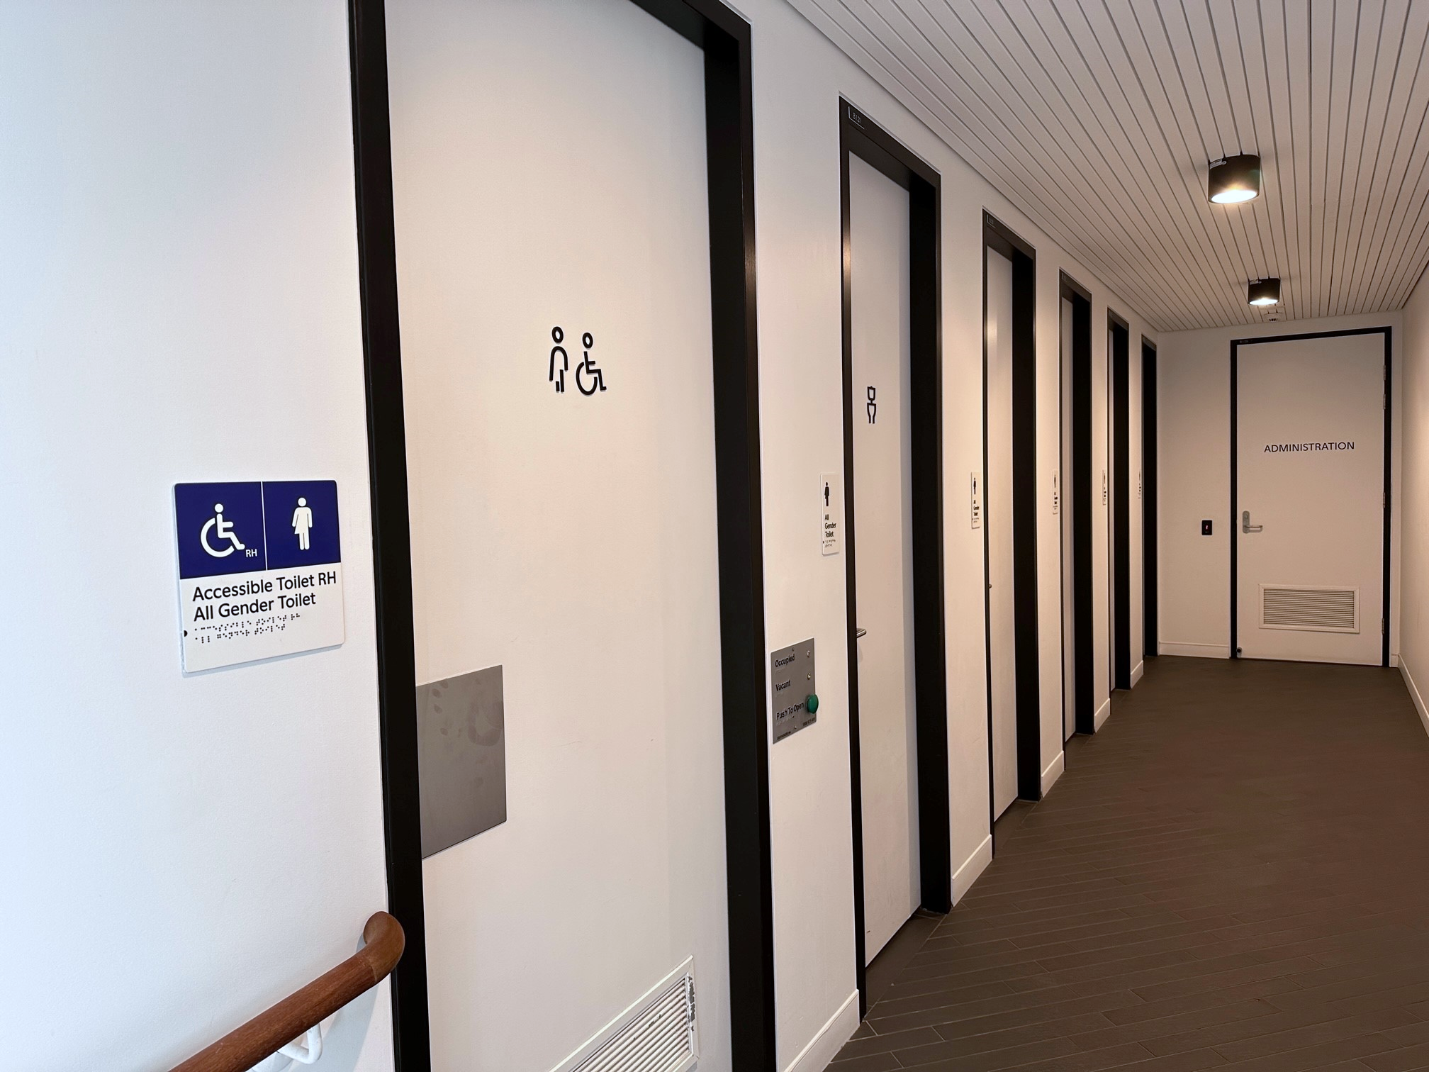
Public Toilets
Accessible toilets are on Level 1 at Mid-Wharf and at the End of the Wharf. This is a short distance from the entrance to Wharf 2 Theatre.
There are ambulant toilets inside the female toilet blocks at the End of the Wharf.
If I need help finding the toilets, I can ask the Accessible Arts staff for help.
ACCESSIBLE ARTS | ACCESS, IDEAS AND INSIGHTS: THE FUTURE OF DISABILITY STORYTELLING | VISUAL STORY

Slide 14
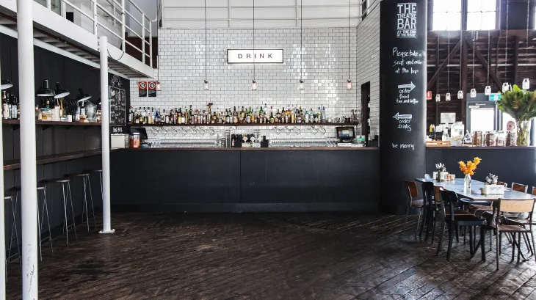
Food and Drinks
Food and drinks are not allowed in the theatre, but bottled water can be taken into Wharf 2 Theatre.
There are several places to eat before and after the event. The closest option is The Theatre Bar at the End of the Wharf, open from Monday to Friday, 9am to 9pm.
For more information about the menu, click here:The Theatre Bar at the End of the Wharf
ACCESSIBLE ARTS | ACCESS, IDEAS AND INSIGHTS: THE FUTURE OF DISABILITY STORYTELLING | VISUAL STORY

Slide 15
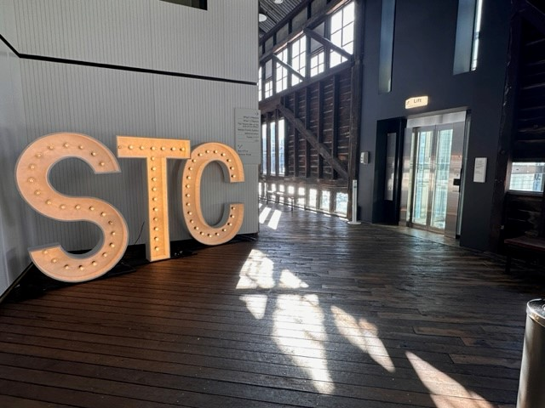
Leaving the event
After the event, the audience is encouraged to join a relaxed networking session at the Theatre Bar at the End of the Wharf. I can choose to attend this or leave the event.
To exit, I can leave Wharf 2 Theatre and use any of the lifts on Level 1 along the Wharf, which will take me to the Pier or Hickson Rd.
I can find out more information about Sydney Theatre Company by clicking here: Sydney Theatre Company
ACCESSIBLE ARTS | ACCESS, IDEAS AND INSIGHTS: THE FUTURE OF DISABILITY STORYTELLING | VISUAL STORY

